Slide 1

Talent Development Program
Module 3 : Data Warehouse
Session 1: OLTP vs OLAP
Notes:
This template can be used as a starter file for presenting training materials in a group setting.
Sections
Right-click on a slide to add sections. Sections can help to organize your slides or facilitate collaboration between multiple authors.
Notes
Use the Notes section for delivery notes or to provide additional details for the audience. View these notes in Presentation View during your presentation.
Keep in mind the font size (important for accessibility, visibility, videotaping, and online production)
Coordinated colors
Pay particular attention to the graphs, charts, and text boxes.
Consider that attendees will print in black and white or grayscale. Run a test print to make sure your colors work when printed in pure black and white and grayscale.
Graphics, tables, and graphs
Keep it simple: If possible, use consistent, non-distracting styles and colors.
Label all graphs and tables.

Slide 2
Session Overview
1
2
OLAP
3
Archive Data Warehouse
OLTP
Notes:
This is another option for an Overview slide.

Slide 3

Learning Objectives
Explain what an OLTP is and its use
Explain what an OLAP is and its use
Discuss how OLTP differs from OLAP
Explain when an Archive Data Warehouse might be used
Notes:
What will the audience be able to do after this training is complete? Briefly describe each objective how the audience will benefit from this presentation.

Slide 4
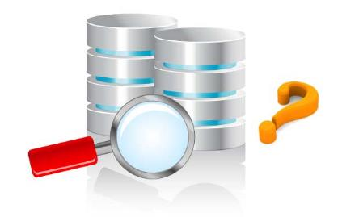
Why is an OLTP?
Online Transaction Processing
OLTP = Data Base
Smaller system with focus on organization of data for efficiency working in real time
System in place that allows for transactions to happen

Slide 5

Why is an OLAP?
Online Analytical Processing
OLAP = Data Warehouse
Larger systems that can contain 50+ years of data
Main focus is storing large amounts of data for use in analysis and computation to find trend or measurable for upper management

Slide 6
Features in OLAP
Dimensions
Tables in a data warehouse used to store descriptive data
Facts
Tables in a data warehouse used to stored mathematical or analytical data for measurements
Surrogate Keys
Replacement for primary keys
Auto incremental keys for only use in the data warehouse for finding data
Business Key
Key used to connect or reference a key in an OLTP

Slide 7
OLTP vs OLAP
OLTP
OLAP
Data Base
Less than 1 year of data typical
Optimized for searching data in real time and normalization
Less likely to have a large number of indexes or partitions
Data Warehouse
More than 50 years of data typical
Optimized for storing and analyzing data when needed and is de-normalized
More likely to have larger numbers of indexes and partition for the data

Slide 8
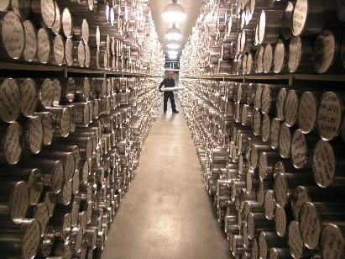
Why is an Archive Data Warehouse?
An offline portion of the data warehouse
You can store much older data that is no longer being referenced
Helps to optimize search through data by shrinking the amount of data available for search

Slide 9
Questions?
Notes:
Is your presentation as crisp as possible? Consider moving extra content to the appendix.
Use appendix slides to store content that you might want to refer to during the Question slide or that may be useful for attendees to investigate deeper in the future.

Slide 10

Summary
Explain what is an OLAP and an OLTP
Discuss the difference between the database and data warehouse
List the features only found in a data warehouse
Explain what an archive data warehouse is and how it can be used
Notes:
Summarize presentation content by restating the important points from the lessons.
What do you want the audience to remember when they leave your presentation?
Save your presentation to a video for easy distribution (To create a video, click the File tab, and then click Share. Under File Types, click Create a Video.)

Slide 11
Thank You
Notes:
Is your presentation as crisp as possible? Consider moving extra content to the appendix.
Use appendix slides to store content that you might want to refer to during the Question slide or that may be useful for attendees to investigate deeper in the future.

